Slide 1
Path Models
Beaujean Chapter 2

Slide 2
Diagrams
Reminder:
Circles are latent (unobserved) variables
Squares are manifest (observed) variables
New
Triangles can be used to represent intercepts
(I have found that you do not normally estimate these except on specific model types multigroup and latent growth).

Slide 3
Diagrams
Reminder
Straight arrows are “causal” or directional
Non-standardized solution -> these are your b or slope values
Standardized solution -> these are your beta values
Curved arrows are non-directional
Non-standardized -> covariance
Standardized -> correlation

Slide 4
Diagrams
Reminder:
All endogenous variables have to have error terms.
Why is the arrow going into the variable?
Because the error in the model is not explained by any other variable (otherwise it wouldn’t be error).

Slide 5
Why standardized?
Using the standardized solution:
Allows you to compare path coefficients for strength of relationship
Makes the non-directional relationships correlation (more interpretable)
Matches the values you are used to thinking about (CFA-EFA).

Slide 6
Why unstandardized?
The unstandardized solution
Allows you to estimate future scores and interpret path coefficients, in the original scale of the data

Slide 7
LAVAAN
Install lavaan
Latent variable analysis package used with this book for R

Slide 8
LAVAAN Syntax
Model = ‘model stuff’
You can use = or <-
Model stuff depends on the picture you are trying to make.

Slide 9
LAVAAN Syntax
Automatic things for you:
Automatically adds an error term to each endogenous variable
AND automatically constrains the path to 1 for you.
Automatically adds a covariance term between all exogenous variables
Super helpful for CFAs
Not always required in path models, but you could constrain it to zero if you have df problem.

Slide 10
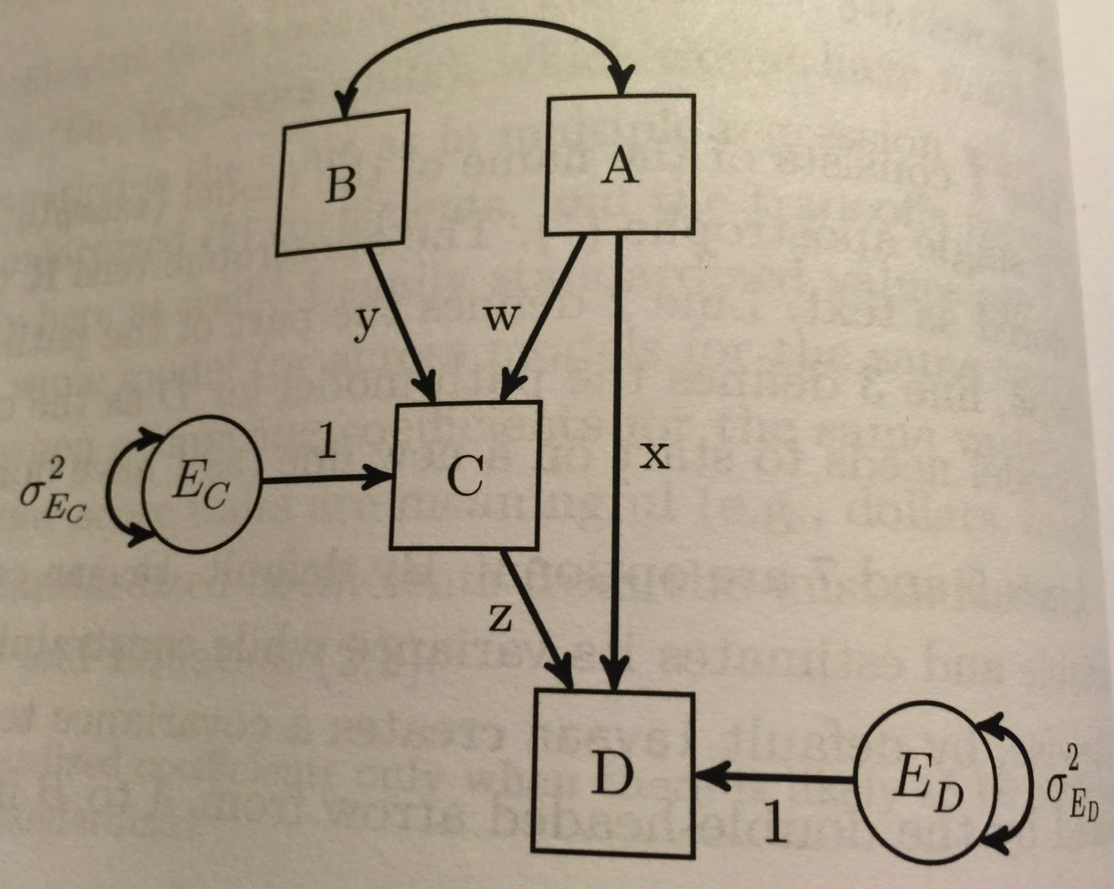
LAVAAN Syntax

Slide 11
LAVAAN Syntax
First, let’s estimate df and make a list of things that will get calculated for us.

Slide 12
LAVAAN Syntax
A = q12 (wanted to take)
B = q2 (clear and organized)
C = q4 (fair grading)
D = q1 (overall eval)

Slide 13
LAVAAN Syntax
model = '
#c ~ a + b
q4 ~ q12 + q2
#d ~ c + a
q1 ~ q4 + q12
’
(note what I did)

Slide 14
LAVAAN Syntax
So, you do not have to label the paths and errors. You can if you want to think about how each variable is being calculated, but complex models that would be very tedious.
You do have to label all the directional arrows.

Slide 15
LAVAAN Syntax
Page 28 is a handy place to save.
We will go over each piece as we use it.
(examples of when the code is relevant seems like it might make more sense to me).

Slide 16
LAVAAN Syntax
What is now stored in model?
Note: \n = new line code
Note: # will still be ignored lines

Slide 17
LAVAAN Syntax
Ok, so I’ve got my model built, now what?
Use the sem() or cfa() functions to run the model.
Sem and cfa have a ton of options, but the simplest is the following:
sem(model, data = data)

Slide 18
LAVAAN Syntax
Lavaan uses normal-theory max likelihood as the default (yay!).
You can change that under estimator – use the help guide for all the options.
?sem or ?cfa to get the help to open.

Slide 19
LAVAAN Syntax
Get the output with the summary function.
summary(saved sem model)
What do you get?

Slide 20
LAVAAN Syntax
Automatically:
N
Estimator (math)
Minimum function test statistic (X²)
df
p

Slide 21
LAVAAN Syntax
Automatically:
Parameter estimates (unstandardized)
SE
Z
p
Error variances

Slide 22
LAVAAN Syntax
IMPORTANT
All the cool stuff is turned off.
Use:
summary(stored,
standardized = TRUE,
fit.measures = TRUE,
rsquare = TRUE,
modindices = TRUE)
We’ll go over these more in depth later.

Slide 23
LAVAAN Syntax
Let’s draw what we got and interpret it.

Slide 24
How to get a picture
Install semPlot package
Use semPaths(stored sem model).
semPaths(path,
whatLabels="par",
layout="spring")

Slide 25
How to get a picture
What labels can also equal std for standardized solution
Layout
tree, circle, spring, tree2, circle2
(I just tried one until it was readable).

